Slide 1
Advocacy & Self-Advocacy
Welcome

Slide 2
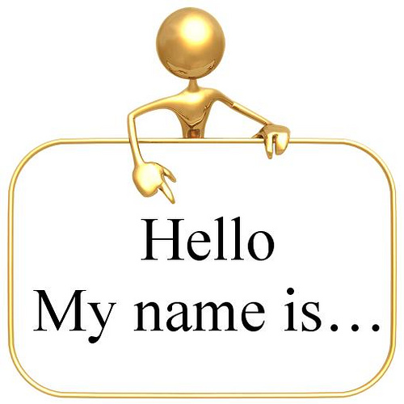
Darrilyn McCrerey, Director of Advocacy
The Arc of Washington County
Thank you for joining us today!
Notes:
Introduction

Slide 3
The Arc of Washington County is an affiliated chapter of The Arc of Pennsylvania and The Arc of the United States.
Our mission is to promote the human rights of people with intellectual and developmental disabilities and actively supports their full inclusion and participation in the community throughout their lifetimes.

Slide 4
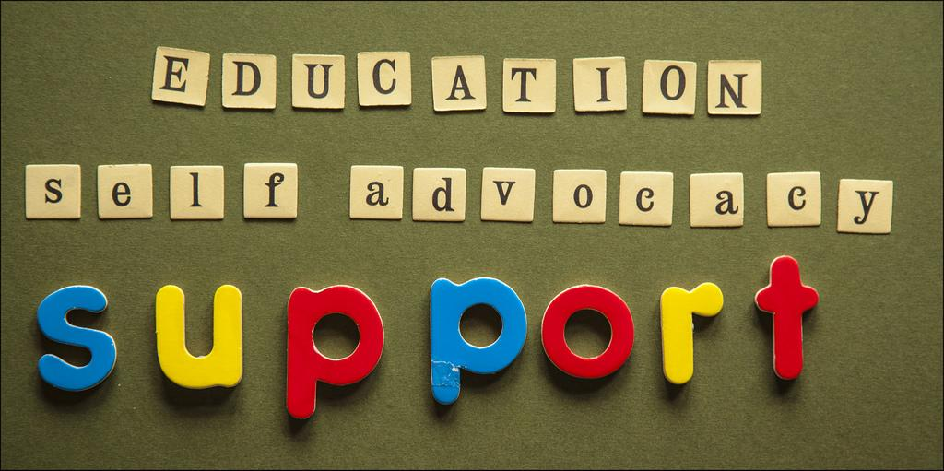
Our goals are simple...Advocacy, Assistance, Assurance and Accessibility

Slide 5
The Arc of Washington County has two components:
Advocacy:
Advocate and speak up for the rights of a person with a disability, sharing information, resources, assisting families and individuals in navigating services, and connecting families.
Self-Advocacy:
Using your voice to speak up for yourself and take control over your own life. Self-Advocacy starts with understanding your strengths and weaknesses, developing personal goals, standing up for yourself, understanding rights and responsibilities and making decisions.

Slide 6
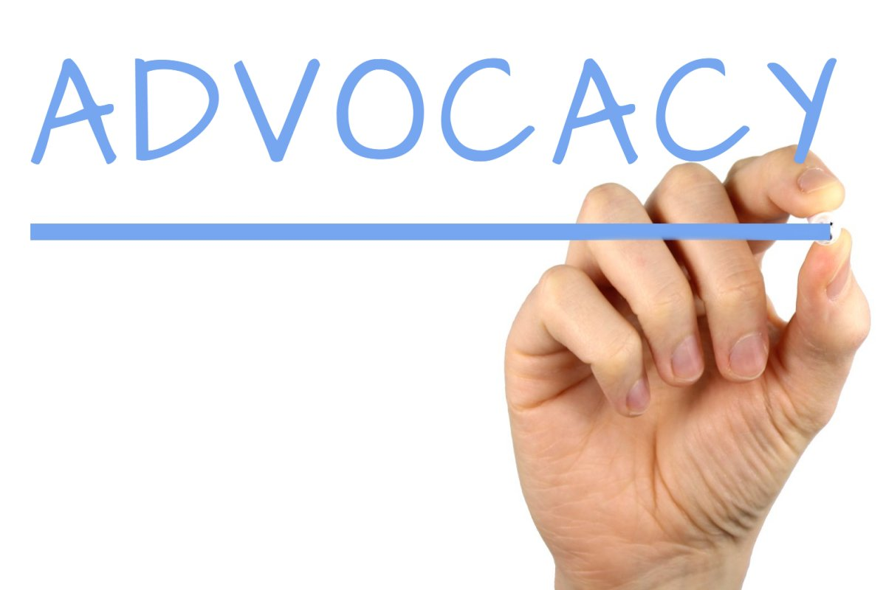
We advocate for the rights and full participation of all children and adults with intellectual and developmental disabilities.
We offer support to help navigate and explain the ever-changing systems of support and services.
We assist individuals and their families to ensure that their educational needs are met.
We connect with school districts and offer MeToo2 sexuality training
We connect families and share resources
“Connecting Families” group
Monthly meetings/training

Slide 7
Self-Advocacy
Monthly Meetings - Open to anyone interested in being a Self-Advocate and learning how to speak up for themselves.
We facilitate learning through creative strategies on topics such as:
Self- Awareness
Self-Advocacy
Problem solving skills
Understanding Rights & Responsibilities
Setting goals
Relationships
The power of one’s personal story

Slide 8
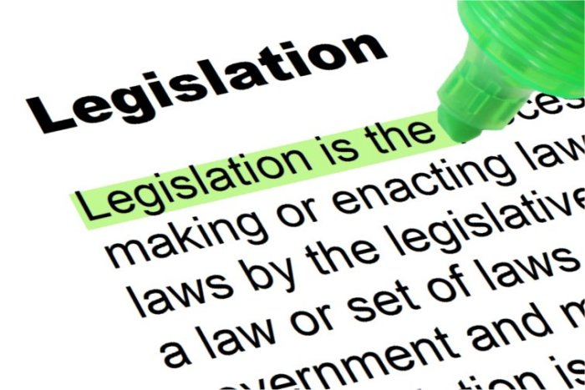
Legislative visits
Assist Self-Advocates that are interested in meeting with elected officials.
Prepare and deliver concerns to Legislators that affect people with disabilities.
Maintain contact
Sending letters

Slide 9
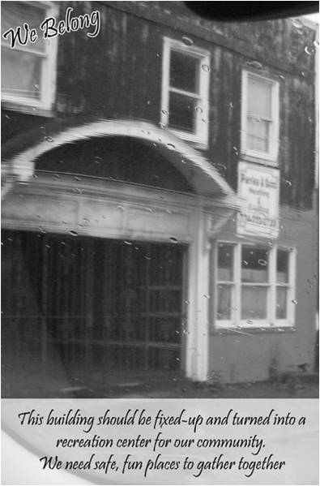
“We Belong”
PhotoVoice Project
Self-Advocates took photos of:
what they liked in their community
what they didn’t like in their community
what they wanted to see changed in their community
Self- Advocates use their voice through photography to show they can and do Belong to their community!!
Continued efforts occur with this project to Educate, Raise Awareness and Acceptance for people of all abilities.
Photos displayed in multiple locations...
The power of a photograph with the power of words makes a powerful impact!

Slide 10
We currently have 3 paid Self-Advocate Leaders/mentors:
Meet on a weekly basis
Host events
Planning committees
Talent show, 4th of July float
Provide support and guidance to peers
Assist in developing a larger Self-Advocate network
Newsletter - with feedback from larger group
Self-Advocate Leadership Group

Slide 11
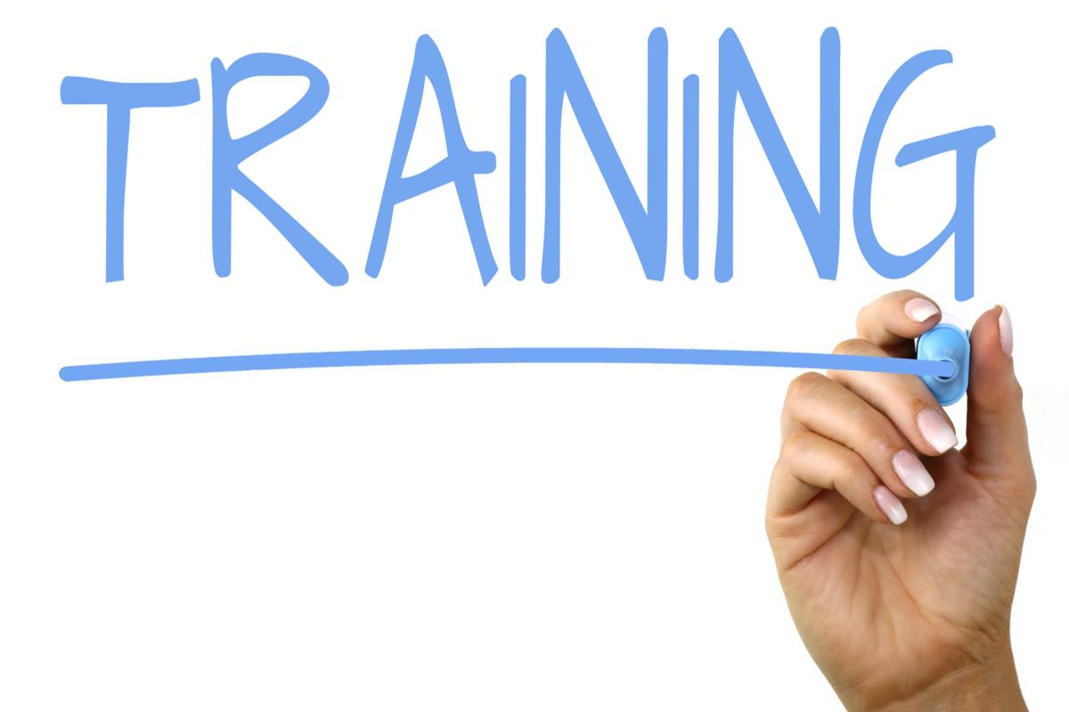
The group develops and provides training for other Individuals and/or Direct Support Professionals:
Now Offering:
“What is Self-Advocacy?”
“Relationships”
“Understanding your Rights & Responsibilities”
Individual/Self-Advocate version
“Understanding our Rights & Responsibilities”
Direct Support Staff version

Slide 12
Our Self-Advocacy program
is funded and supported by Washington County BHDS
We are honored to have the opportunity to teach and guide people with disabilities to effectively use their voice and speak up for themselves and truly be a part of making their own decisions about their everyday life!!!
Please share the information with anyone that may be interested in joining our group.
Together we can make a change!

Slide 13
Like us on Facebook.com/thearcofwashpa
Self-Advocacy private group
Connecting families private group

Slide 14
Thank you for your time!
Please contact me with any questions and/or to schedule a training with our mentors…
Darrilyn McCrerey
mccrereyd@arcofwashpa.org
724-745-3010 x 109
Visit our website for more Information and/or become a friend of The Arc of Washington County
www.archumanservices.org

